Slide 1
15.763 Administrative Issues
Friday April 29 is last scheduled recitation, due to May 6 conflict
  Review concepts from this week, answer anything about BigFig
Quick refresher on leading versus lagging capacity acquisition strategy
There is no assignment due for Monday Class 10
  Read the posted paper
  Class will discuss interplay of capacity, inventory, forecast, demand, and leadtime

Slide 2
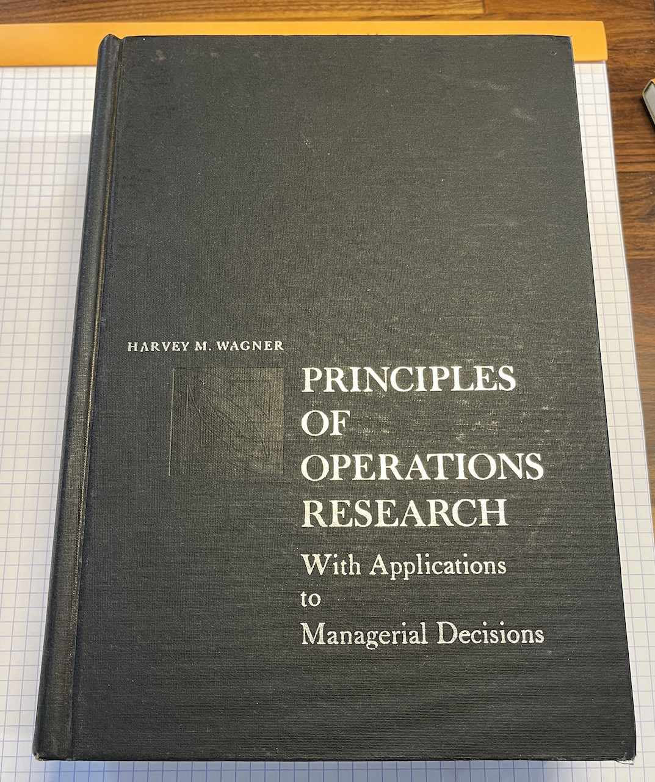
Harvey Wagner’s Principles of Operations Research
https://www.abebooks.com/servlet/SearchResults?sts=t&cm_sp=SearchF-_-home-_-Results&tn=principles%20of%20operations%20research&an=wagner
Make sure to get the 1st edition (1969) not second edition
$5.98 on AbeBooks

Slide 3
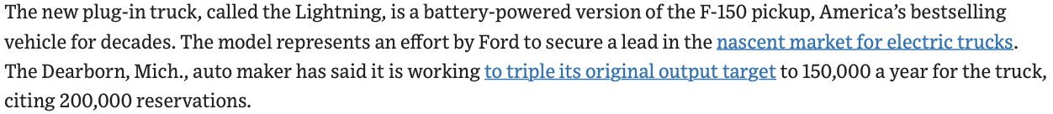
If It Was Easy, Everyone Would Do It
Tesla sold ~950,000 cars in 2021, and produced ~300,000 cars in Q4
Ford sold ~ 3,900,000 cars in 2021
Tesla’s achievements to this point are incredible. And the reward for good work is…
How do you take advantage of the opportunity you are given?

Slide 4
Flexibility in Supply Chains
What is flexibility?
How to achieve flexibility?
Motivating case example
Reference
  Jordan, Graves “Principles on the Benefits of Manufacturing Process Flexibility,” Management Science, April 1995
Flexibility is the ability to respond to change (versus disruption)
What type of changes?
  Demand volume
  Demand mix
  Product features
  Process or technology changes
  Job priorities
  Process yield
  Supply uncertainty

Slide 5
Problem Motivation At General Motors
Forward planning in automotive industry for allocating products to assembly plants
Flexibility - Ability to build different product types in the same plant at the same time
Problem characteristics:
  Product demand is very uncertain, average forecast error > 50%
  Cost of unfilled demand or poorly utilized capacity is very high
  Flexible capacity is very expensive
Questions:
  How much flexibility should each plant have?
  What is the best way to deploy flexibility across the plants?

Slide 6
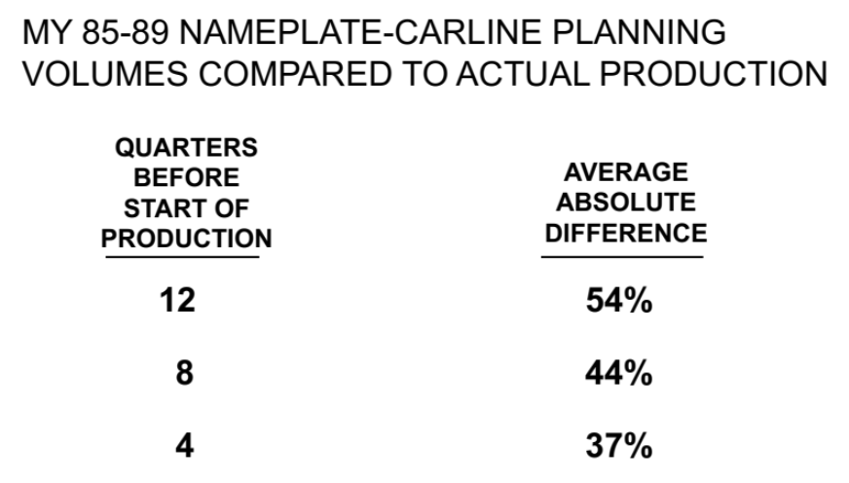
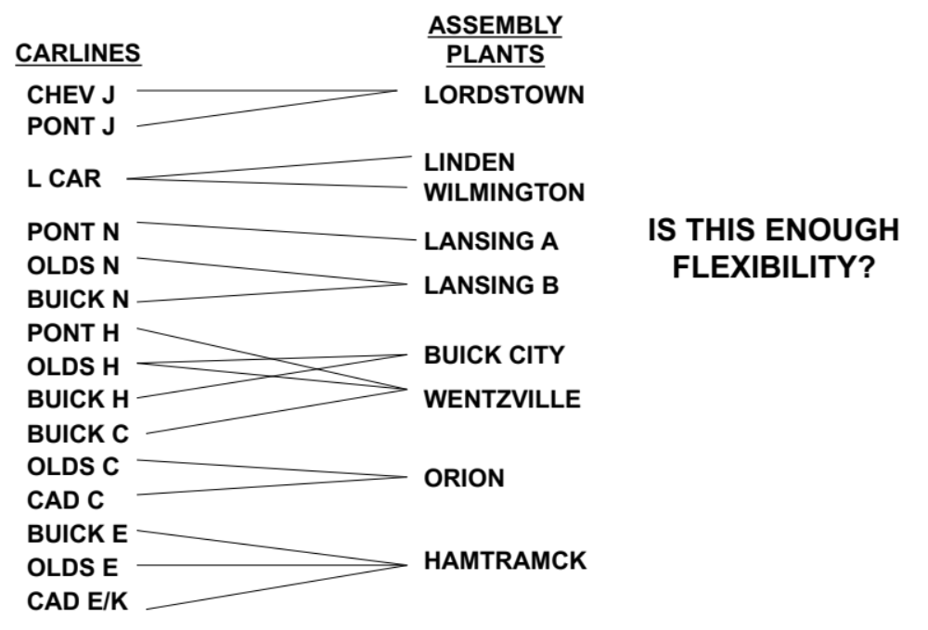
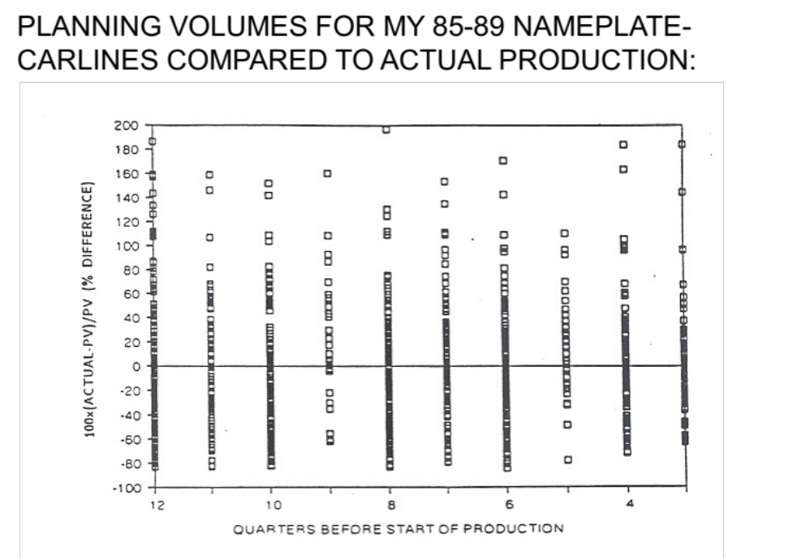
Existing Product Allocations

Slide 7
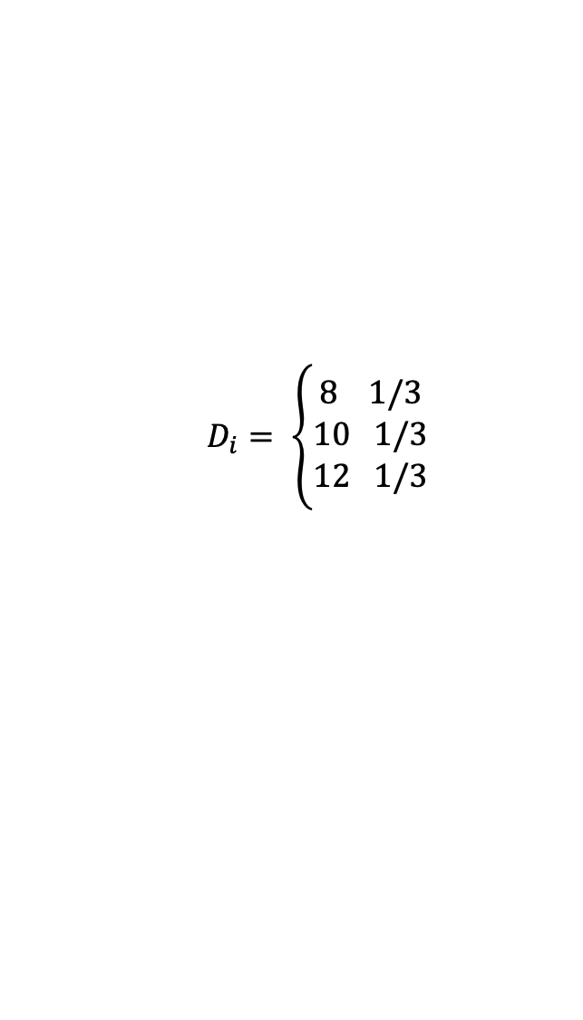

Motivating Example
Base Case, dedicated system of repair personnel, each trained to repair a type of watch (4 hrs/watch). No cross training.
Each has capacity to repair 10 watches/week; 40 hrs/week
Adam
A
Bob
B
Carol
C
Dianne
D
Each job takes 4 hours
E
Edith
Fred
F

Slide 8
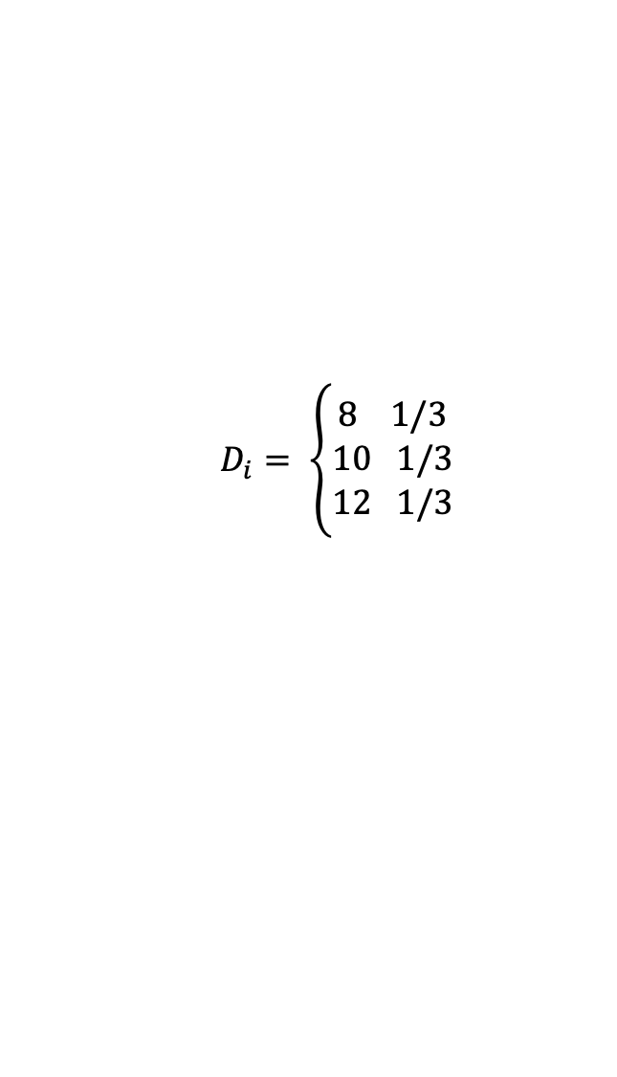

Expected Overtime = 16 hours/week
Adam
A
Bob
B
Carol
C
Dianne
D
Edith
E
Each job takes 4 hours
Fred
F

Slide 9

Expected Overtime = 15.11 hours/week
8
A
Adam
D = 8
2
Bob
10
B
D = 12
Carol
C
Dianne
D
Edith
E
Fred
F

Slide 10
Train Bob on C, Reduce OT To 13.93 hours
Adam
8
A
8
2
Bob
8
B
10
2
Carol
C
12
10
Dianne
D
Edith
E
Fred
F

Slide 11
Train Carol on D, Reduce OT TO 12.54 hours
Adam
A
Bob
B
Carol
C
Dianne
D
Edith
E
Fred
F

Slide 12
Train Dianne on E, Reduce OT To 11.03 hours
Adam
A
Bob
B
Carol
C
Dianne
D
Edith
E
Fred
F

Slide 13
Train Edith on F, Reduce OT to 9.42 hours
Adam
A
Bob
B
Carol
C
Dianne
D
Edith
E
Fred
F

Slide 14
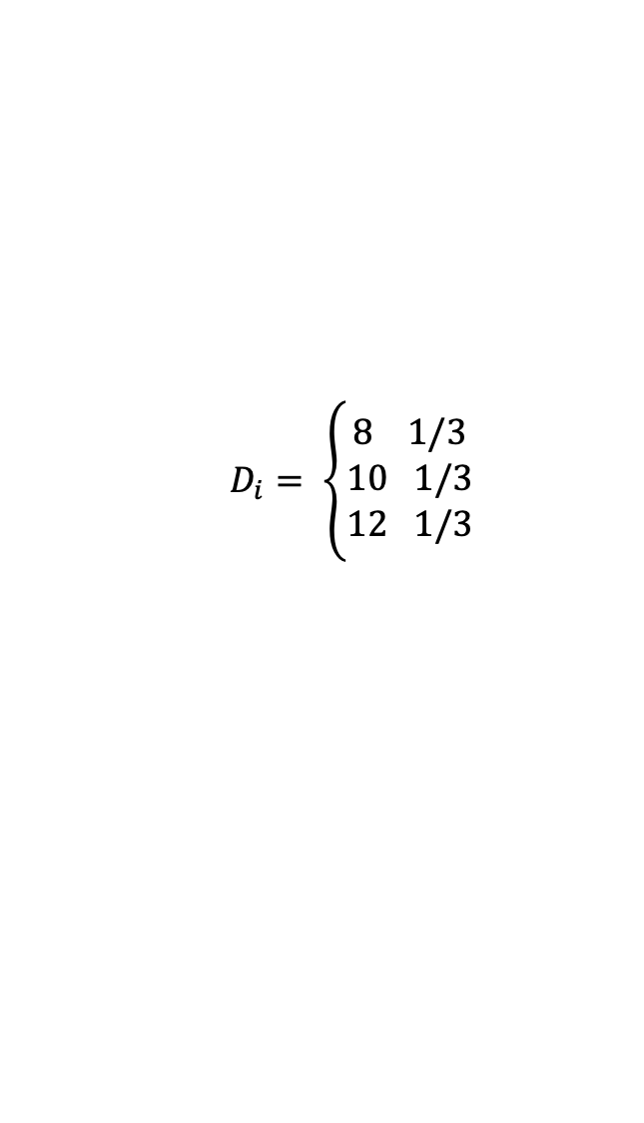

Train Fred on A, Reduce OT To 6.32 hours
Completing the chain allows capacity available to flow across the network to satisfy constrained resources
Adam
A
Bob
B
12
Carol
C
Dianne
D
Edith
E
8
Fred
F

Slide 15
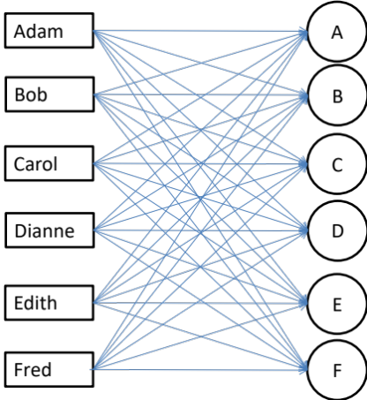
Total Flexibility Does Little Relative To Chaining
Configuration | E[overtime]
Dedicated | 16.0
Add 1 link | 15.1
Add 2 links | 13.9
Add 3 links | 12.5
Add 4 links | 11.0
Add 5 links | 9.4
Add 6 links | 6.3
Add all links | ????
Adam
A
Bob
B
Carol
C
Dianne
D
Edith
E
Fred
F
Notes:
This is quite interesting…. Why such an improvement from this last link?
Basically this last link allows free capacity from lower sources to flow to help upper sources…. Eg, suppose Demand for E = 8 and demand for B = 12, we can now utilize excess Edith’s excess capacity to help out Bob…
Can we do better with more training?

Slide 16
Observations From Example
A small amount of flexibility added in the right way can have virtually all the benefits of total flexibility.
The right way to add flexibility is to create a longer resource-product chain.
Incremental value of additional flexibility increases until chain is closed

Slide 17
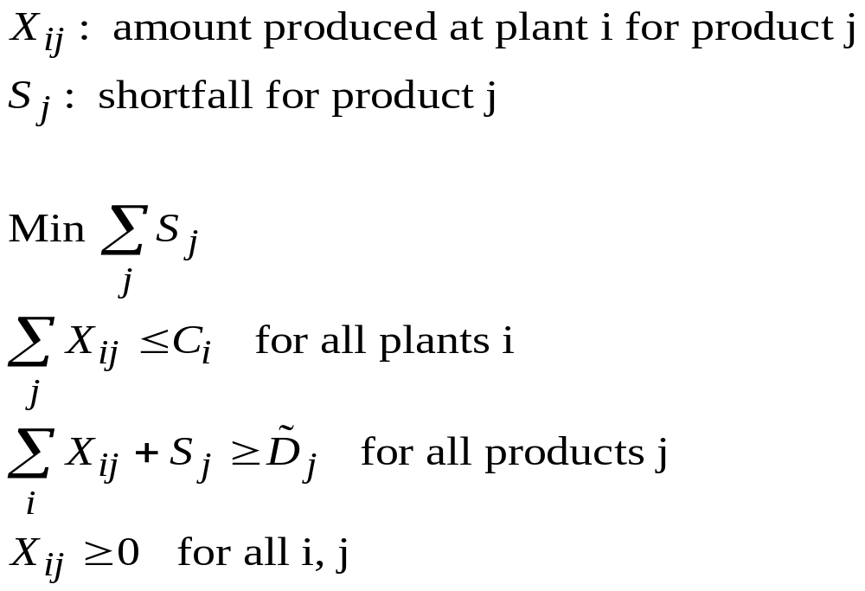
FlexCap: Simulate Demand, Optimize Allocations
Underlying optimization problem is very simple (which is a good thing)

Slide 18

Chaining Yields the Greatest Benefits
ONE CHAIN
FIVE CHAINS
PRODUCTS
PLANTS
PRODUCTS
PLANTS
A
1
A
1
B
2
B
2
C
3
C
3
D
4
D
4
E
5
E
5
F
6
F
6
G
7
G
7
H
8
H
8
I
9
I
9
J
10
J
10

Slide 19
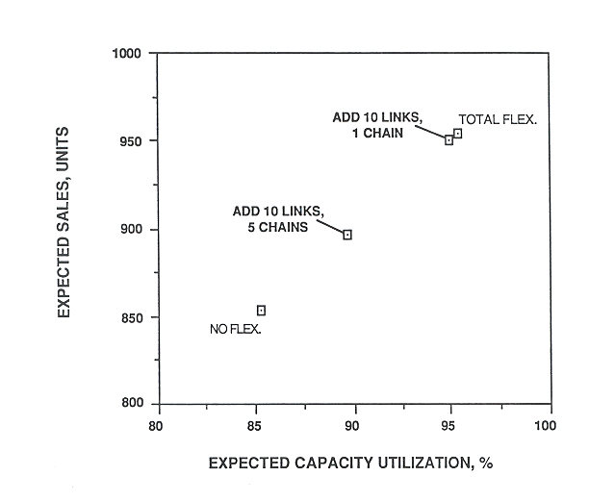
One Chain vs. 5 Chains

Slide 20
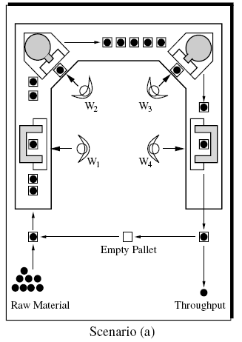
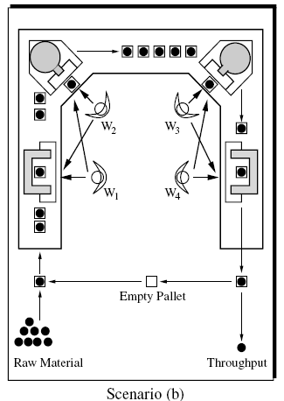
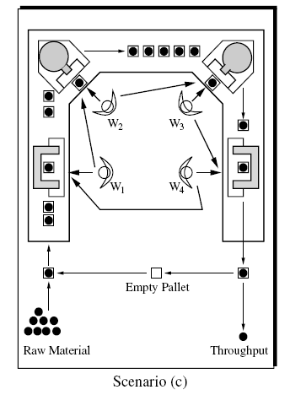
Cross-trained workers (Hopp et al., 2004)

Slide 21
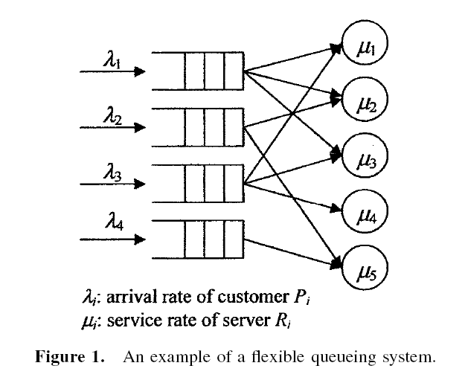
Flexible Queueing System (Gurumurthi and Benjaafar, 2004)

Slide 22
Conclusion
Flexibility is
  one more way to absorb variability
  a way to achieve pooling benefits
A small amount of flexibility can capture all the benefits of total flexibility
Long chains are most effective
Results are generalizable across systems
There are alternative optima; which is good news

Slide 23

Please complete the end-of-class two-question survey
What is your main learning?
What is your unanswered question?
https://bit.ly/15763end

